Slide 1
Observatory of Central Africa Forests (OFAC) From data collection to a regional decision support system
Florence Palla & Quentin Jungers
FRA 2020 : Technical meeting of National Correspondents and CFRQ partners
5-9 March 2018 Toluca, Mexico

Slide 2
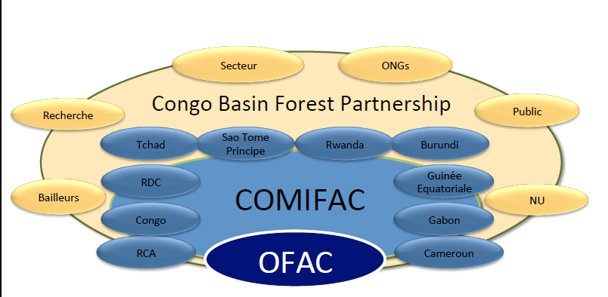
OFAC Network
=> Ensure permanent availability of information on the forests in the region (10 countries) to decision makers and the broader public.

Slide 3
Historical process
OFAC, FTPs, National groups
Common workshops - OFAC, ITTO, FAO-FRA
+ common Focal Points
Main Correspondent
Identification of the data to be collected
Data collection and online encoding
Updates, corrections and validation
Online publication, States of Forests, …
Quality control
National validation workshop
OFAC
National groups and partners
National groups
(Focal points and main correspondent)
Data collection
Analytical platforms
Diffusion - DSS
Notes:
FTPs : Financial and Technical partners
Groupes nationaux inter-ministériels

Slide 4
New mechanism
Regional workshop in order to :
Assess and clarify OFAC indicators
Identify new indicators (spatial data, COMIFAC CP, NTFPs)
Harmonize with global process
2. Data collection :
Centralization around COMIFAC National Coordination cells
Consistency with national statistics
Integration/sharing with COMIFAC partners process
2. Data encoding :
Reduce the encoding efforts (get previous data unchanged)
Historical data consolidation
Identification of the data to be collected
Data collection and online encoding
Updates, corrections and validation
Online publication, States of Forests, …
Quality control
National validation workshop
Data collection
Analytical platforms
Diffusion - DSS
Notes:
Consolidation des données historiques avec les annuaires statistiques nationaux

Slide 5
Historical OFAC themes
 | Regional | National | Management sites
 |  |  | Forest concessions | Protected areas
Forest cover
Forest explotation (logging)
Biodiversisty conservation
Juridical and legal framework
4 themes
Data collection
Analytical platforms
Diffusion - DSS

Slide 6
New monitoring systems
Observatory of Protected areas (with the help of BIOPAMA program)
Field data collection – management effectiveness assessement
Analyses and online analytical tools
Regional Information System (with mapping interface
Inventorying and monitoring environmental initiatives in Central Africa
Project/program document collection
Mapping interface, with analytical and reporting tools
Evaluate the contributions by countries, domains of activity, protected areas and networks
Evaluate the contributions for local, national regional and global objectives
New emerging themes
Non-Timber Forest Products (NTFP)
Spatial indicators
Marine protected areas
Landscape restoration
…
Data collection
Analytical platforms
Diffusion - DSS

Slide 7
Development of analytical platforms
10 years of data collection but not enough analyses/feedback
Reorganization of the website analytical tools around a new mapping interface
Declination of tools and information by themes (national data, protected areas, projects/initiatives, NTFPs, …)
Simple reporting tools responding to different users needs
Data collection
Analytical platforms
Diffusion - DSS

Slide 8
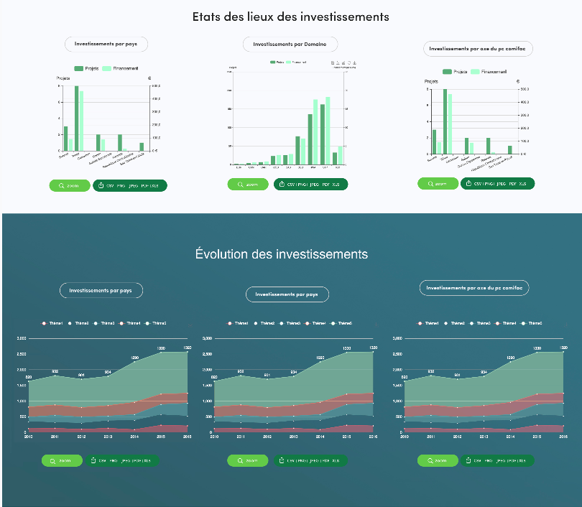
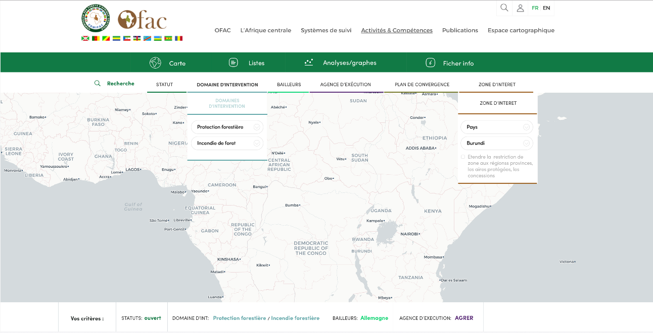
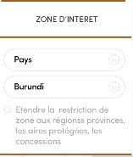
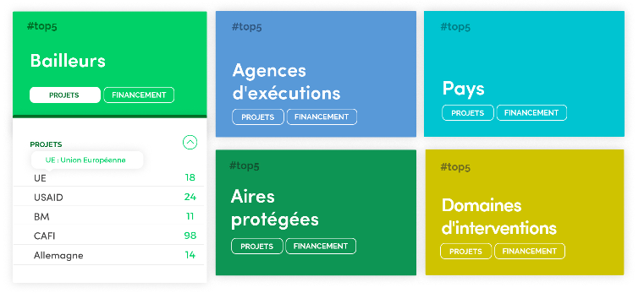
Example : PROJECTS platform
Structure de la plateforme : 4 onglets
Entrée par une interface cartographique
Navigation aux moyens de critères de recherche
Statut du projet
Zone d’intervention
Baillleur
Agence d’exécution
Domaine d’activité
Axes du PC COMIFAC
Répertoire de projets
Interactif (s’adapte avec les critères de recherche)

Slide 9
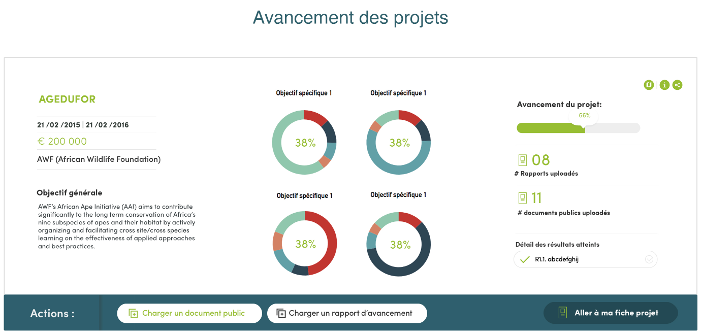
Decision support systems
OFAC needs to be an “information broker”
Improve interactivity and efficiency in the diffusion of information (online platforms)
Simple reporting tools responding to different users needs
Adapt tools, information and reporting design according to different user needs
Traditional OFAC publications
States of Forests – 2020/2021
States of Protected Areas -2019
Policy briefs on emerging themes
National legal wood supply policies
Importance of national and regional markets
“Zero deforestation” goals
NDCs
NTFPs : potential for diversification of national economies…
…
Data collection
Analytical platforms
Diffusion - DSS
Notes:
Ici, l’objectif de l’illustration est de montrer que les infos et outils sont formatés selon les profils d’utilisateurs. On a donc un exemple avec les projets ou on a des outils de suivi de l’avancement et des objectifs destinés aux managers de projets et aux bailleurs

Slide 10
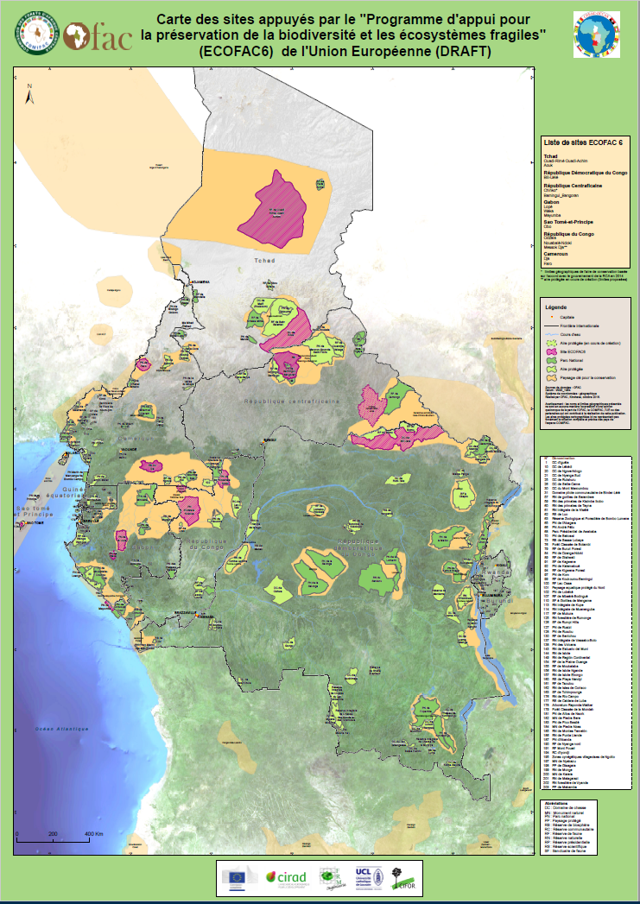
Decision support systems
Thematic maps and other support for decisioners
Last example : protected areas supported by ECOFAC 6 program
Data collection
Analytical platforms
Diffusion - DSS

Slide 11
Thank you
http://www.observatoire-comifac.net

