Slide 1
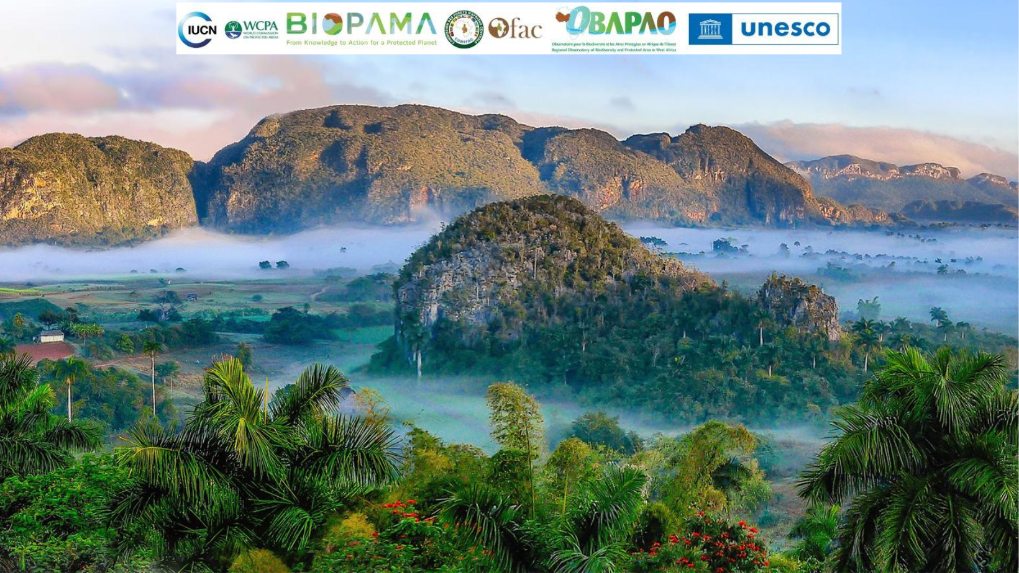
Introduction:
How to help countries interpret and then convene implementation of the Global Biodiversity Framework, especially Target 3 and 30x30 ambitions
James Hardcastle, Head, Protected and Conserved Areas, IUCN

Slide 2

30% - a starting point for a healthy planet
People need fair and effective nature conservation to help secure health and livelihoods
2022 IPCC Report + IUCN Res 125 call for 30-50% of our planet under effective area-based conservation
GBF has 23 Targets. Goal A calls for effective systems of protected and conserved areas to cover at least 30% of the planet by 2030 (Target 3, and generally 1-4)
Protected and conserved areas, and indigenous and traditional territories, are essential to conserve all areas of importance for biodiversity
They can deliver biodiversity conservation and societal benefits, including climate contributions
They must be fairly governed, recognize rights and help advance equity
They must be managed effectively to maintain their values

Slide 3
Target 3
Ensure and enable that by 2030 at least 30 per cent of terrestrial and inland water areas, and of marine and coastal areas, especially areas of particular importance for biodiversity and ecosystem functions and services, are effectively conserved and managed through ecologically representative, well-connected and equitably governed systems of protected areas and other effective area-based conservation measures, recognizing indigenous and traditional territories, where applicable, and integrated into wider landscapes, seascapes and the ocean, while ensuring that any sustainable use, where appropriate in such areas, is fully consistent with conservation outcomes, recognizing and respecting the rights of indigenous peoples and local communities, including over their traditional territories.

Slide 4

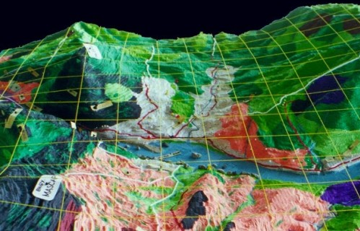
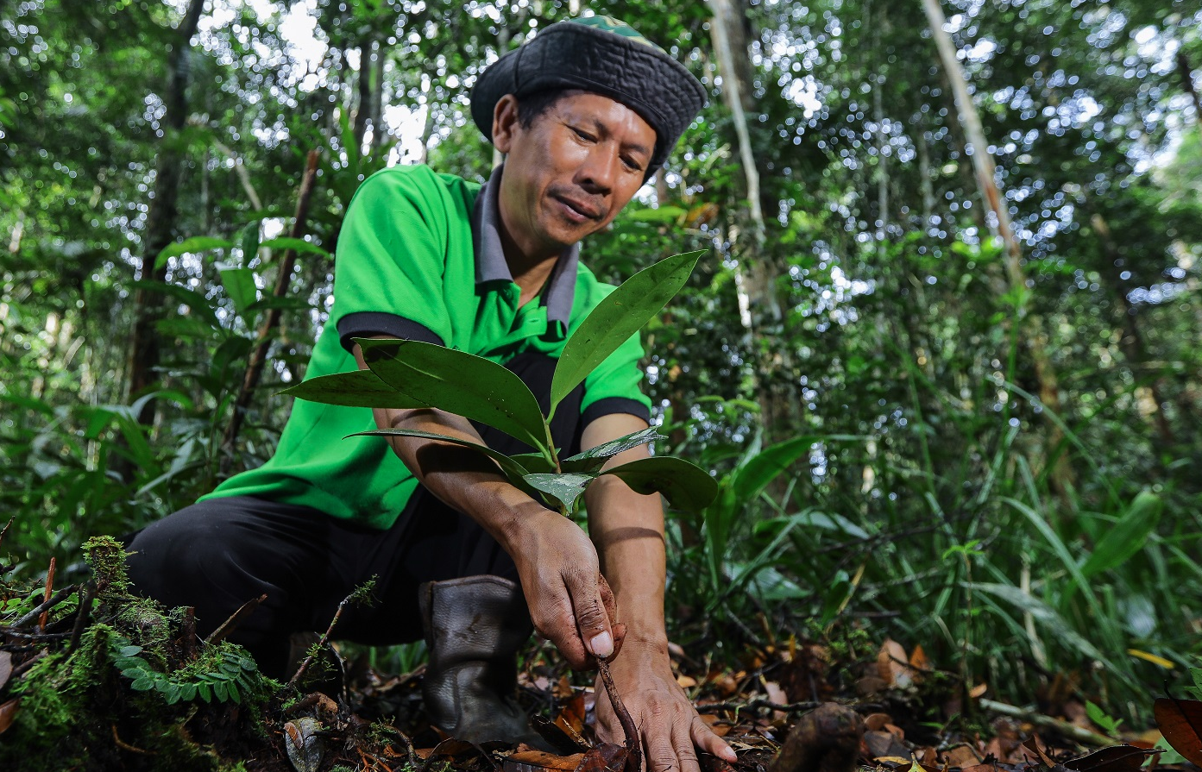




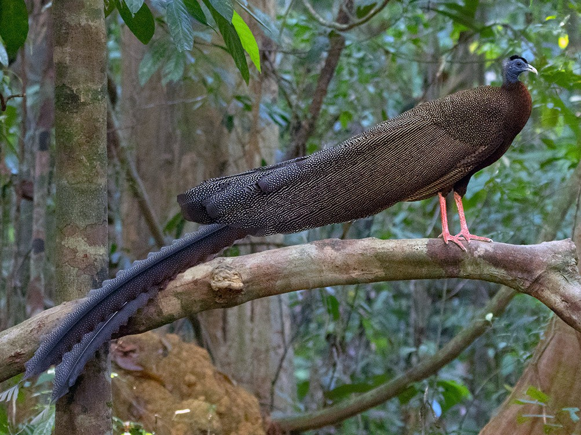
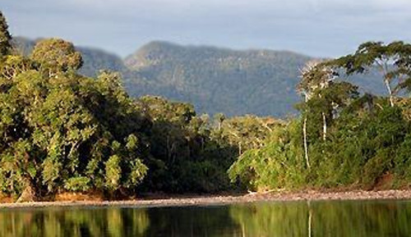
Countries’ spatial planning integrates nature-based solutions for biodiversity, ecosystems and climate, including delineating what and who counts to the global 30% Target of effective area-based conservation by 2030
Target 1 biodiversity-inclusive spatial planning
Restore 30 per cent of areas of degraded terrestrial, inland water, and coastal and marine ecosystems, to enhance biodiversity, ecosystems ecological integrity and connectivity, by 2030
Target 2 30% restoration and recovery for degraded areas
30% Effective area-based conservation - through equitably governed and effectively managed systems of protected and conserved areas, recognizing indigenous lands and traditional territories
Target 3 30% effective area-based conservation
Urgent actions to halt extinction of known threatened species and for the recovery and conservation of species, and effectively manage human-wildlife interactions
Target 4 species conservation action

Slide 5
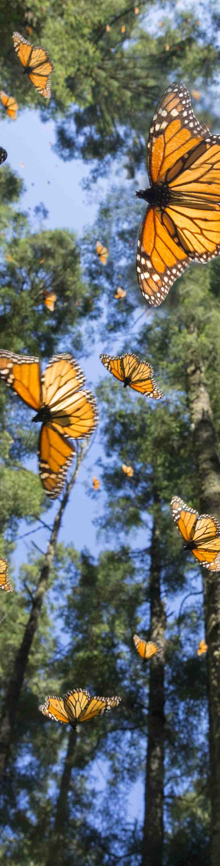
Key challenges & IUCN’s approach
Growth in the number of recognized protected and conserved areas worldwide since 2010 - 43% of the total area added during the decade
Many PAs are insufficiently resourced, lack good governance and struggle to achieve effective management, the Green List Standard can address this
Several indigenous and community conserved territories and areas are not recognized for their sustained conservation contributions,
GBF and T3 offer an opportunity to address this through focus on inclusiveness
In response, IUCN has adopted a parallel approach:
Who Counts
What Counts (Red List, KBAs)
IUCN will recognise and uphold the priorities, perspectives and rights of Indigenous People’s and embed them in all national efforts
Co-developing our IUCN strategy of work with IPs and LCs (IUCN Res 002)

Slide 6
IUCN – convening ‘who counts’ for GBF implementation!
1. Spatial Planning
2. Restoration, connectivity
3. Effective conservation
4. Wild finance
Green List dashboard
Participatory GIS
Tech4Nature
ESRI partnership
Bonn Challenge
Restoration Barometer
ROAM
FLR Chain
IP and LC leadership and ‘Third pathway’
IUCN Green List Standard for PCA
Wildlife bonds
Green List investment KPIs
MPA bonds
Support effectiveness of PAs, OECM
Nature Collectible NFTs

Slide 7
IUCN – supporting members to deliver on the GBF, 30x30
BELIZE
MPA financing mechanism designed with IUCN support
IUCN Green List as the Key Performance Indicator
KOREA
National OECM strategy with IUCN, links to Global Species Action Plan
All Protected Areas committed to the IUCN Green List
ALBANIA
Vjosa Wild River National Park created to IUCN Standards
Transboundary commitments with Greece facilitated by IUCN
VIETNAM
IUCN-led dialogue on effective area-based conservation
IUCN Green List for national PA system

Slide 8
Role of local and traditional knowledge in 30x30
Who counts: identifying and recognising those with knowledge and expertise, and including them in dialogue and process
What counts: helping provide insights into important values, places for effective conservation
Local voice: knowledge and perspectives, as well as customary and de facto governance systems, that can help achieve effectiveness
Local eyes: monitoring trends and progress. Provide foundational knowledge on which to base for scientific confirmation and validation
Local ears: Accountability and responsibility – for all actors in the landscape.

